Slide 1
NAME: M.POOJA
ROLE CHOSEN: CLOUD ENGINEER
COMPANY:TACHYON SYSTEMS PTY.LTD

Slide 2
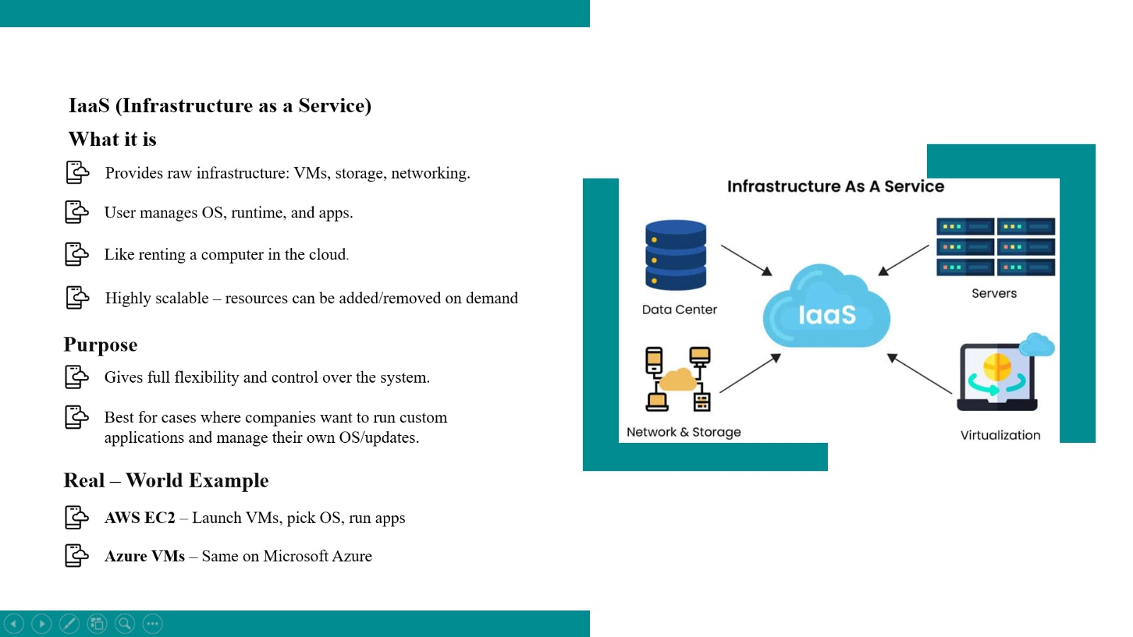

Slide 3

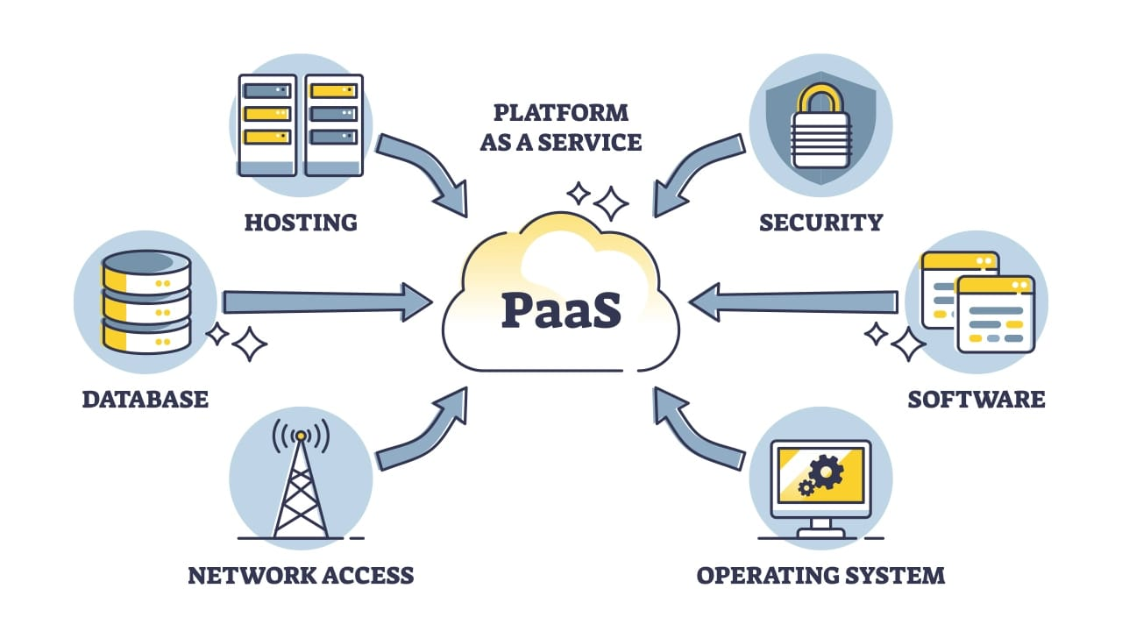
PaaS (Platform as a Service)
What it is
Provider manages OS, runtime, middleware.
You deploy only the application code.
No infra/patching worries → scaling handled automatically.
Speeds up development lifecycle
Purpose
Focus only on coding
Faster app development & deployment
Real – World Example
Azure App Services – Upload app, Azure auto-manages scaling & load balancing
AWS Elastic Beanstalk – Deploy code, AWS provisions infra automatically

Slide 4
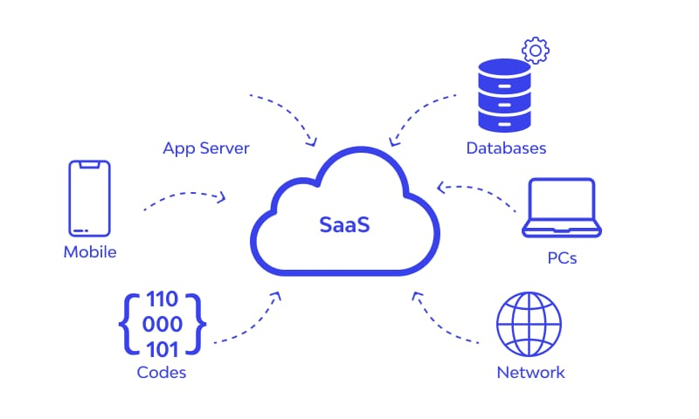
SaaS (Software as a Service)
What it is
Ready-to-use applications delivered over the cloud.
No control over infra or platform → fully managed by provider
Access via browser or app (no installation needed)
Subscription-based model
Purpose
Instant access to full software
No maintenance or IT overhead
Real – World Example
Gmail (Google Workspace) – Google handles servers, storage, scaling
Microsoft Office 365 – Word, Excel, Teams via cloud subscription

Slide 5
SCALABILITY VS ELASTICITY
Aspect | Scalability | Elasticity
What | Ability to handle more load by adding resources (planned/manual) | Ability to auto-scale resources up or down with demand
How | Add VMs, bigger databases, or more nodes | Auto Scaling (AWS), VM Scale Sets (Azure)
Where | Predictable growth (e-commerce, banking) | Unpredictable demand (ride-sharing, food delivery)
Example | Amazon adds EC2 servers before Black Friday → resources stay after sale | Uber auto-scales servers during peak → scales down at midnight to save costs

Slide 6
Key AWS Services
Service | Category | What it is | Key Benefit
EC2 | Compute | Virtual servers in the cloud | Flexible, scalable instances
S3 | Storage | Object storage for unstructured data | 99.999999999% durability, lifecycle management
DynamoDB | Database (NoSQL) | Fully managed serverless DB | Millisecond latency, auto scaling
Lambda | Serverless Compute | Run code without servers | Event-driven, pay per execution
API Gateway | API Management | Managed service for APIs | Security, auth, rate limiting, integration

Slide 7
Key Azure Services
Service | Category | What it is | Key Benefit
Functions | Serverless Compute | Event-driven serverless compute | Run microservices/tasks without servers
Blob Storage | Storage (Unstructured) | Object storage for images, videos, logs | Hot/cool/archive tiers, globally distributed
Cosmos DB | Database (NoSQL, Multi-model) | Globally distributed DB (key-value, doc, graph, column) | Multi-region writes, low-latency, 99.999% SLA
App Services | PaaS (Web Hosting) | Deploy and manage web apps easily | Auto-scaling, CI/CD, multi-language support
Azure SQL DB | Database (Relational) | Fully managed relational database service | High availability, built-in security, scaling

Slide 8
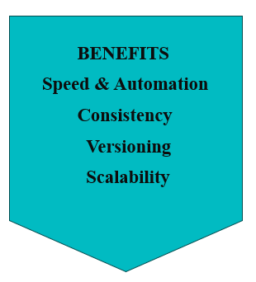
Infrastructure-as-Code (IaC)
What it is
A way to provision and manage cloud infrastructure using code.
Eliminates manual clicks in AWS/Azure consoles
Treats infrastructure the same as application code (can be versioned, tested, automated)
AWS CDK
Framework to define AWS infra using programming languages (Python, TypeScript, etc.).
Converts code → Cloud Formation → AWS resources.
Best for devs who prefer real coding constructs (loops, classes).
Azure Bicep
DSL for Azure resource deployment.
Cleaner, modular replacement for ARM templates.
Best for Azure-only teams, simple & native.

Slide 9
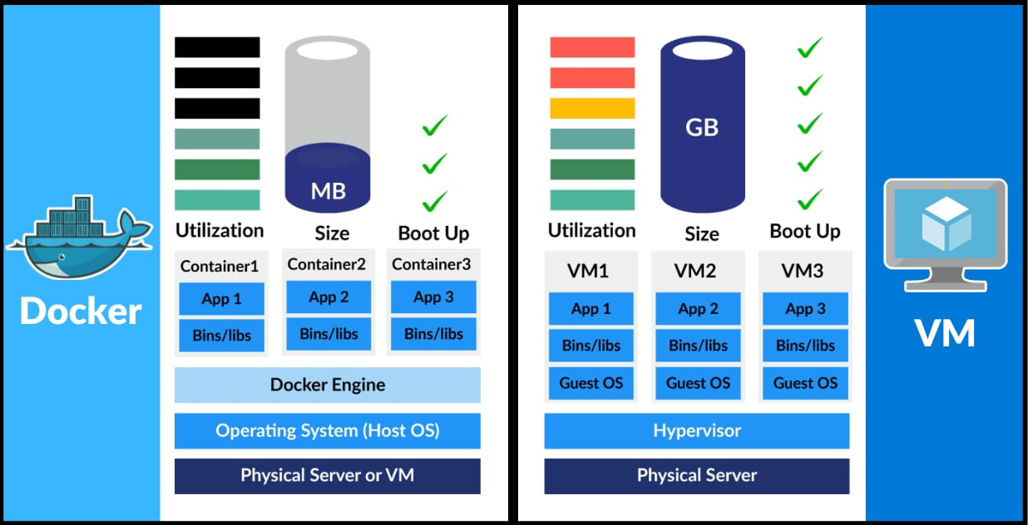
Virtual Machines vs Containers
Containers (Docker) | VMs
Share the host kernel | Full OS per VM
Lightweight, faster, portable | Heavyweight, slower to start
Efficient resource usage | Higher resource usage
Orchestration
ECS (AWS)
→ Simple container orchestration
EKS (AWS)
→ Managed Kubernetes
AKS (Azure)
→ Managed Kubernetes
Use Cases
Deploy microservices → each service in its own container
Scale independently (e.g., payment service scaled more than user profile service)

Slide 10
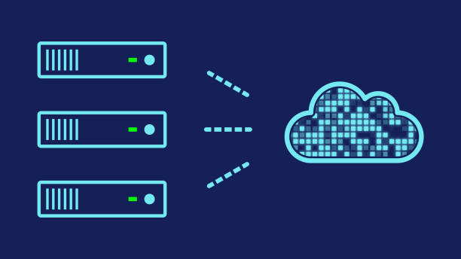
Serverless Architecture
Event-Driven Systems :
Functions are triggered by events like HTTP requests, file uploads, or database changes
Enables on-demand execution without idle resources
Supports loosely coupled architectures, making apps more modular and easier to maintain
Example: AWS S3 → Lambda – Upload a file to S3 triggers a Lambda function to process it automatically
Automatic Scaling :
Resources scale up or down automatically based on demand
No need to pre-provision servers; handles spikes efficiently
Optimizes cost and performance since resources are used only when needed
Example: Google Photos – Automatically scales processing when millions of users upload images

Slide 11
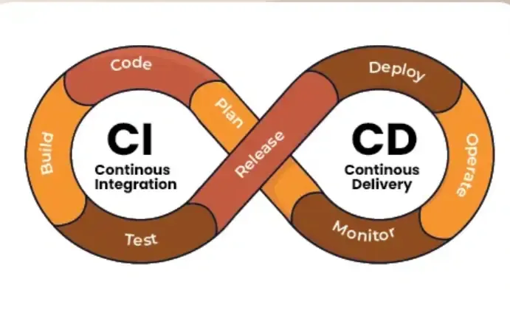
CI/CD Pipelines
What is CI/CD?
CI (Continuous Integration): Frequent code merges + automated testing to catch bugs early
CD (Continuous Deployment): Automatically deliver applications to production after CI passes
Automated Deployment
Code changes are deployed automatically, reducing manual errors
Example: YouTube app updates – New features rolled out seamlessly to millions of users
Monitoring
Tracks app health, performance, and deployment status
Example: CI/CD dashboards (GitHub Actions, Jenkins) alert teams on failures

Slide 12
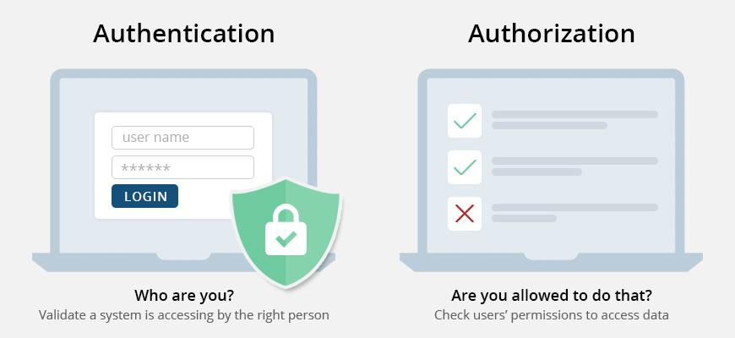
Authentication vs Authorization
Authentication (Who you are) | Authorization (What you can access)
Verifies identity of a user/system | Defines permissions & access levels
Methods: password, ID card, biometrics | Based on roles, groups, or policies
Happens before authorization | Happens after authentication
IAM (Identity & Access Management)
AWS service to manage users, groups, and access policies.
Provides fine-grained control over who can access which resources.
Centralized way to handle authentication and authorization in the cloud.
Role-Based Permissions (RBAC)
Access is assigned based on a user’s role (e.g., Admin, Developer, Viewer).
Simplifies management by grouping permissions instead of setting them individually.
Used in Azure and other platforms to ensure secure, consistent access control.

Slide 13
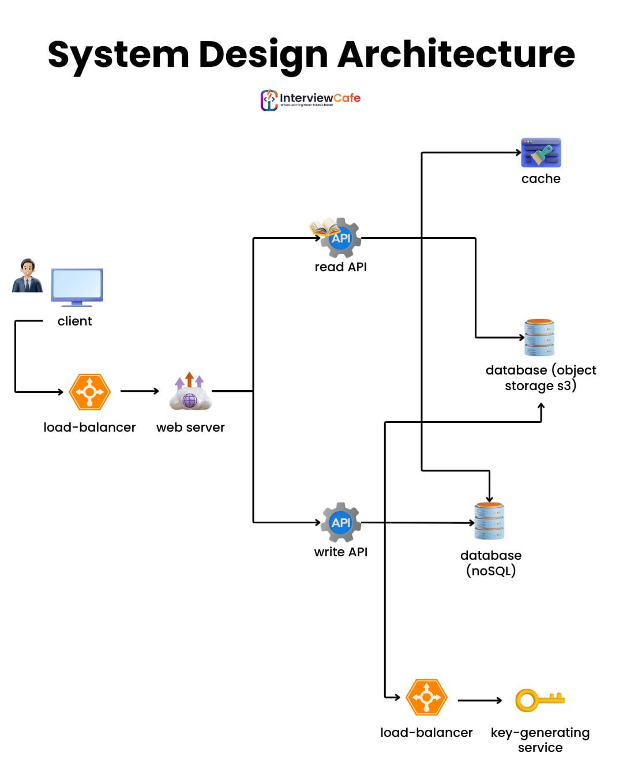
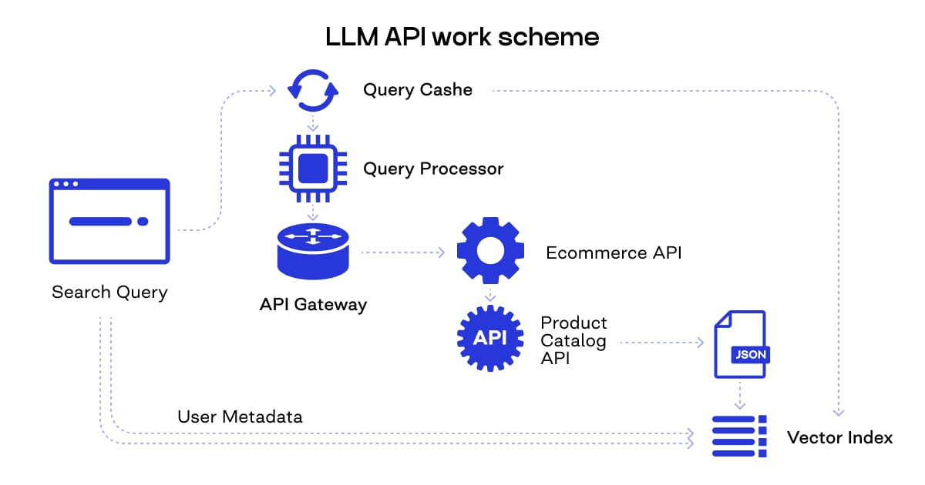
System Design - CDN, Caching & Global Scaling
CDN (Content Delivery Network): Delivers content closer to users worldwide for faster response.
Caching: Stores frequently used data in memory to reduce latency
Global Scaling: Multi-region deployments ensure high availability and reliability
Example: Netflix or Hotstar streaming videos smoothly worldwide.
LLM APIs in Cloud
LLM (Large Language Model): Advanced AI models like GPT
Cloud Advantage: Deploy models as scalable inference APIs
Use Case: Apps send requests to API → model generates response
Example: Chatbots, code assistants, or recommendation systems powered by GPT models.

